Slide 1

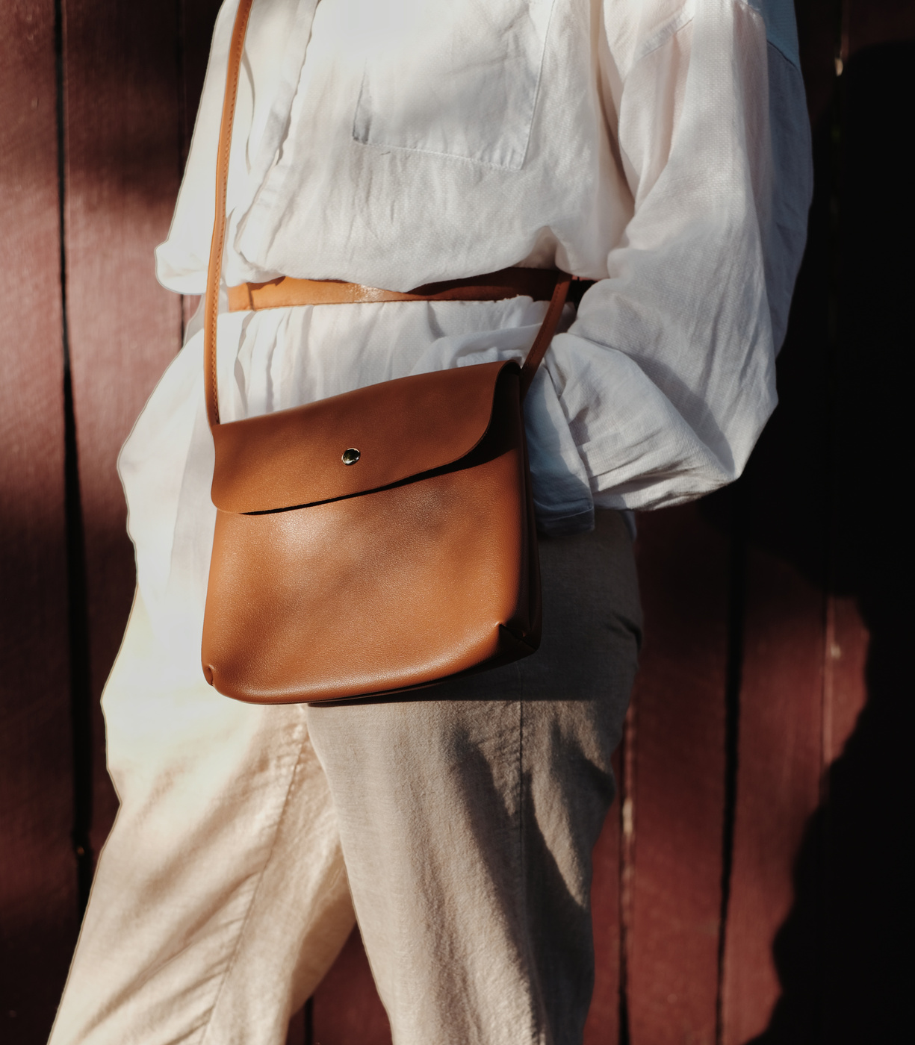
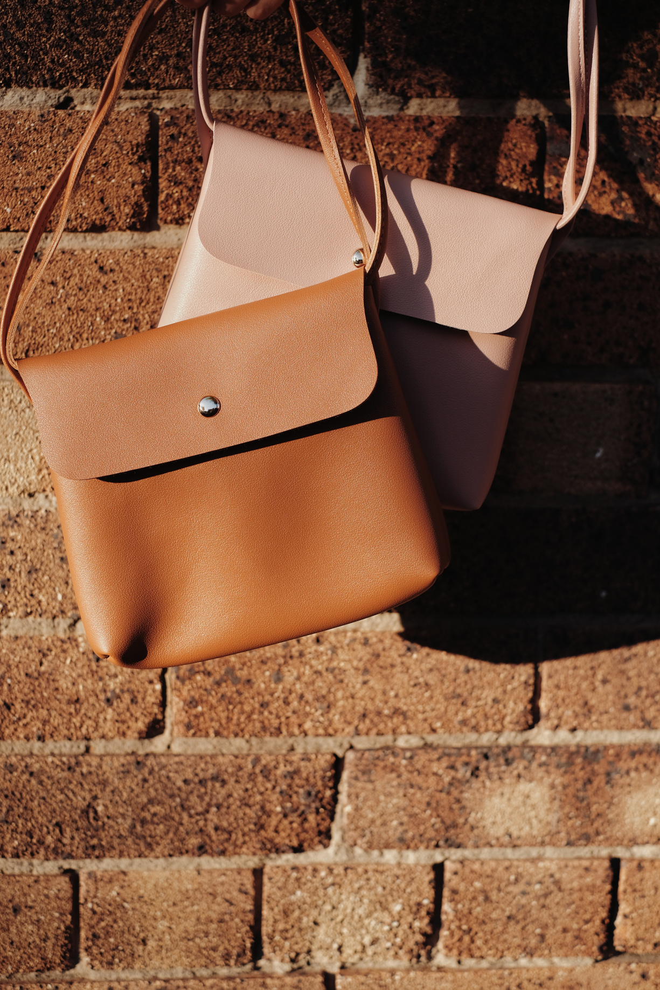
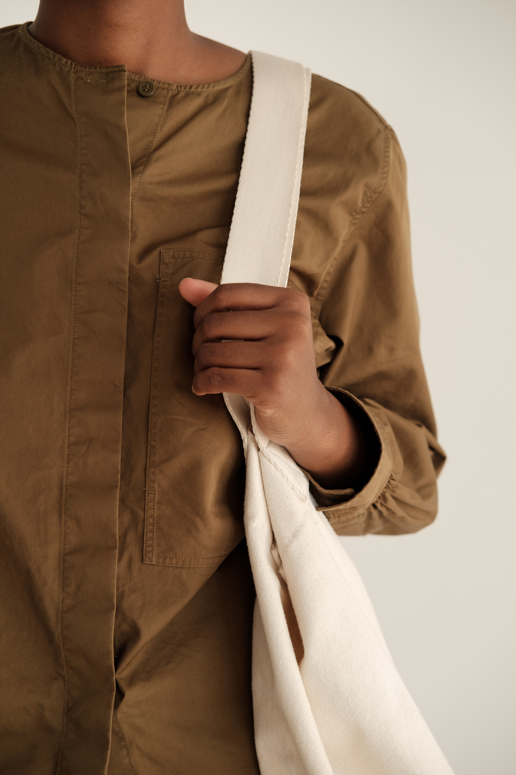

Fashion
Style
VOUGE-VISTA
Style
Fashion Collection
www.vogue-vista.com

Slide 2
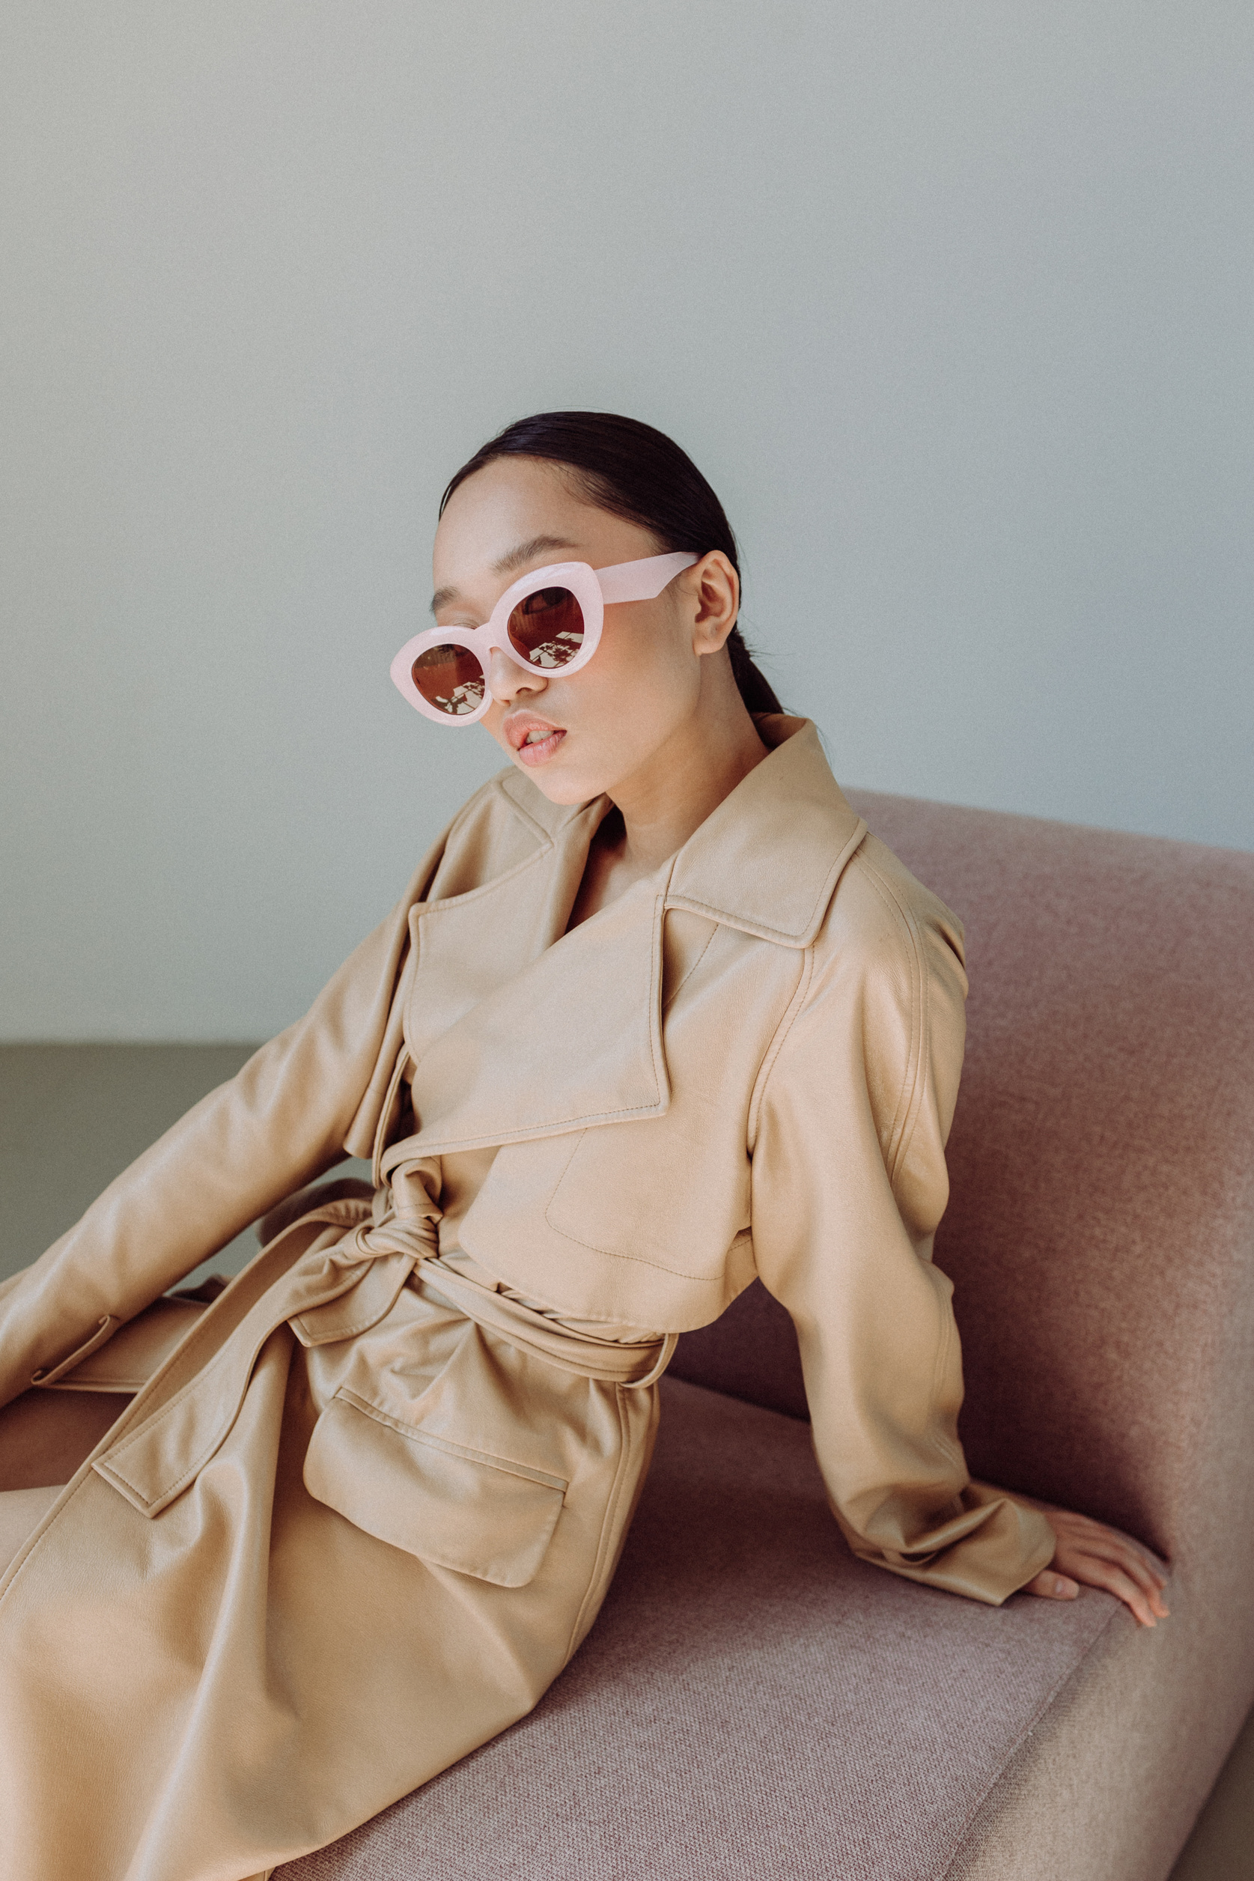
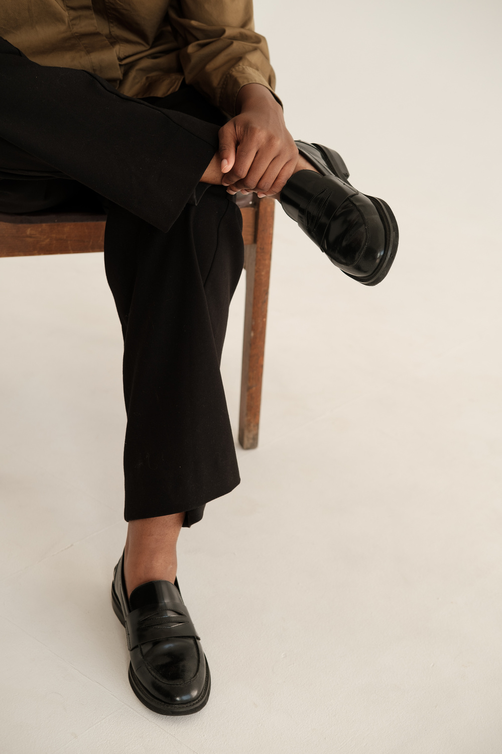
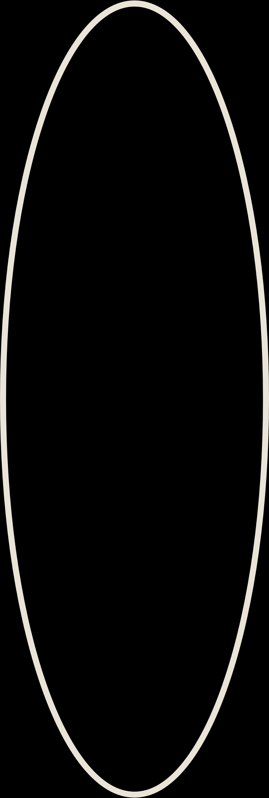
Intro
Introduction
Welcome to vogue-vista, your one-stop shop for stylish and affordable clothing.: Shop our latest collection of dresses, skirts, tops, and more.
Intro
Page 02/07
www.vogue-vista.com

Slide 3
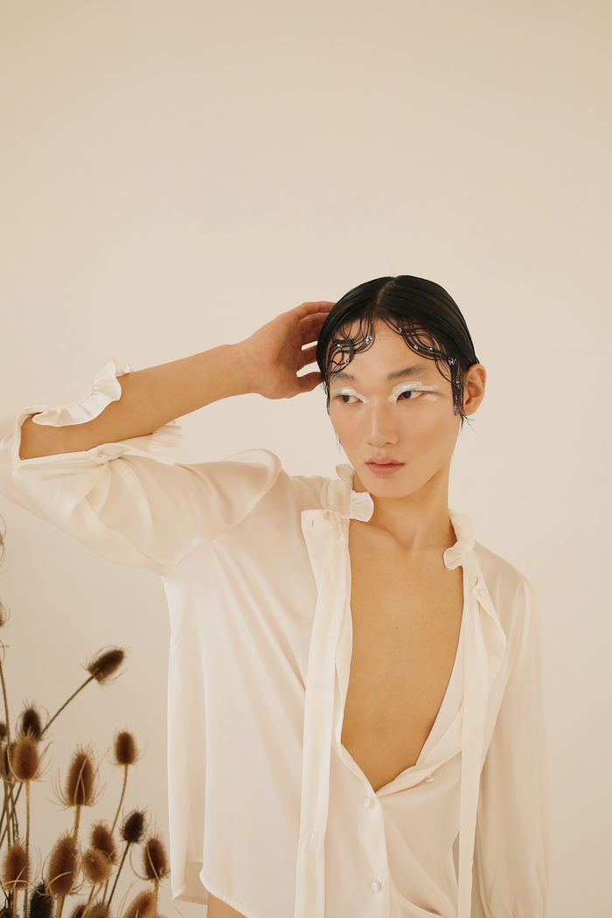
Functionality
In this project I added add to cart and remove product from your cart function with use of javascript.
I also added slideshow function with use of javascript.
I use basic css and html functions and bootstrap also.
Page 03/07
www.vogue-vista.com

Slide 4

Merits
An clothing website allows businesses to reach a global audience without the constraints of physical location. This opens up opportunities for expanding customer base and increasing sales.
This continuous availability ensures that customers can make purchases at their convenience, even outside traditional business hours.
Page 04/07
www.vogue-vista.com

Slide 5
Demerits
While many clothing websites offer shipping options, customers may be deterred by high shipping costs or lengthy delivery times.
Clothing websites may experience technical issues such as slow loading times, website crashes, or checkout errors, which can disrupt the shopping experience and drive customers away.
Page 05/07
www.vogue-vista.com

Slide 6



Stay in touch with us
www.vogue-vista.com
123-456-7890 / vouge-vista@gmail.com
123 Anywhere St., Any City, ST 12345
Page 06/07
www.vogue-vista.com

Slide 7
Bag
Collection
THANKS
Style
Fashion Collection
www.vogue-vista.com

